Slide 1

Predicting Heart Attack Risk: A Data-Driven Approach
Unveiling Insights and Empowering Prevention
Presenter: Alima Hossain Shetu
Date: 01/28/2025

Slide 2

Why Heart Attack Prediction Matters
Heart disease is a leading cause of death worldwide.
Early detection and risk assessment can save lives and reduce healthcare costs.
Highlight the lack of easy tools for prediction, and the benefit of developing them.
The Problem

Slide 3
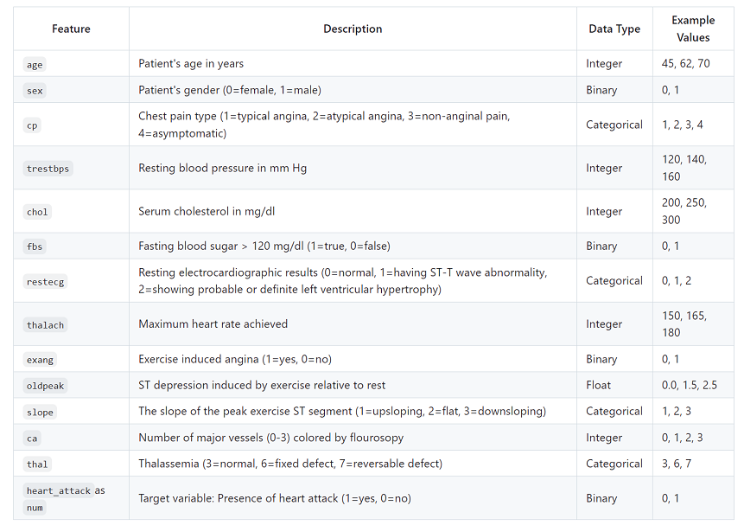
Understanding the Data We'll Explore:
This dataset contains 294 records of patient data with 14 features. The data includes both numerical and categorical features, providing a comprehensive view of patient health conditions related to heart health.
Target Variable:The target variable is `heart_attack`as ‘num’ , which is a binary indicator (e.g., 1 for heart attack, 0 for no heart attack).
Data Source: This dataset was compiled from a public repository Kaggle
Data Overview

Slide 4
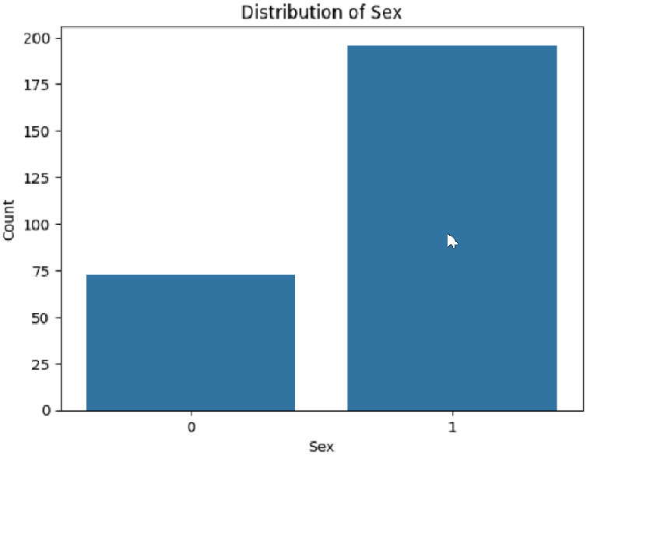
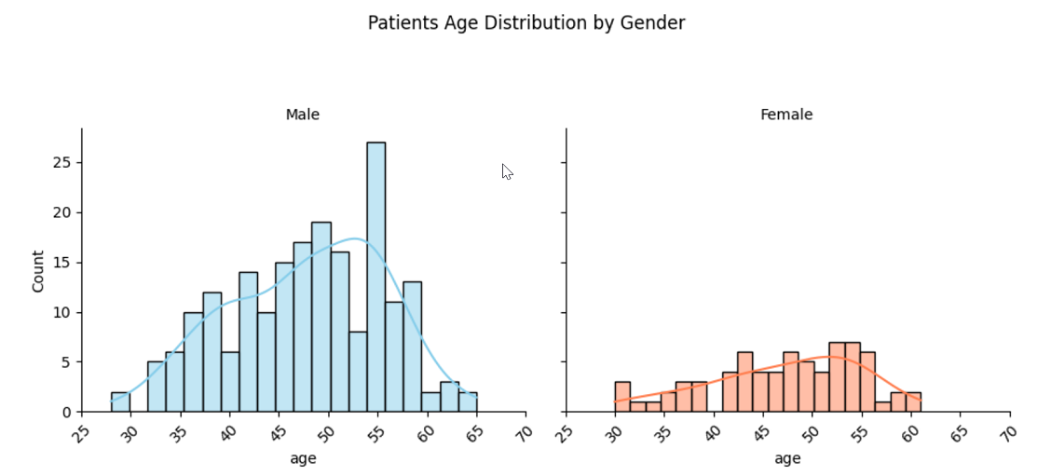
Demographic Breakdown
Patient Demographics:
bar chart is showing the proportion of males and females.
Histogram plot showing the gender- wise age distribution of patients.

Slide 5
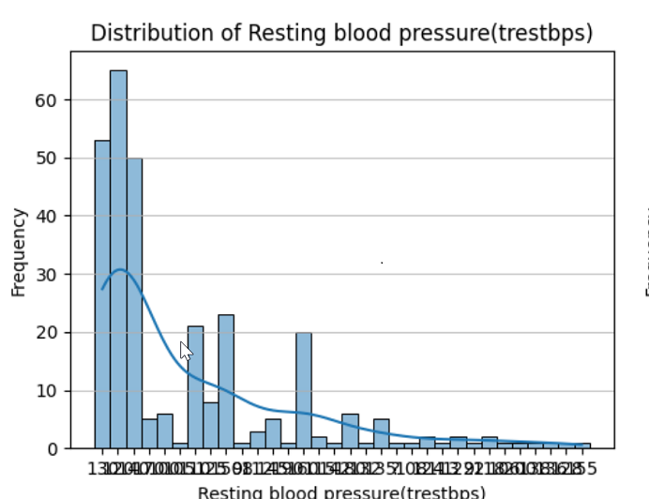
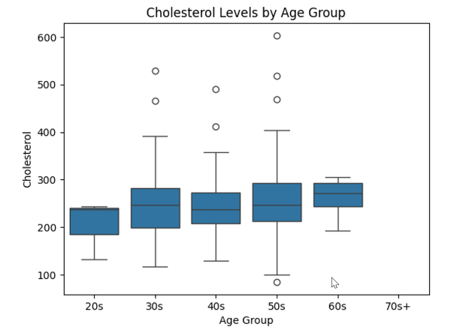
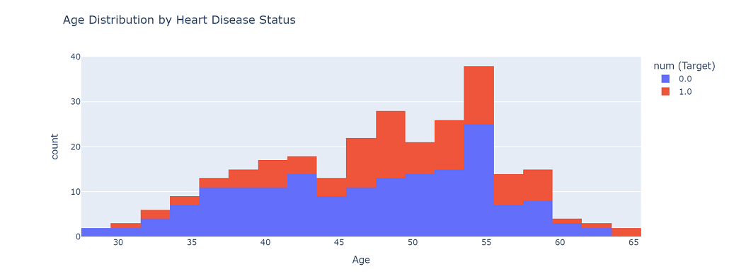
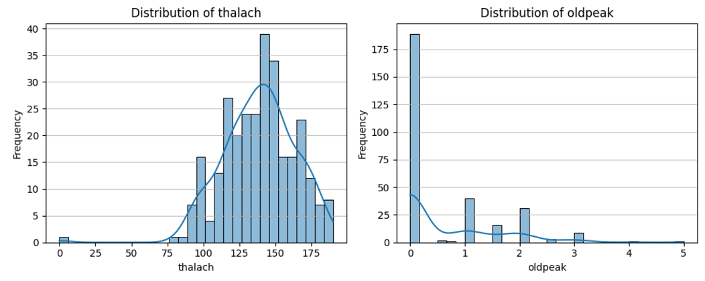
Examining Risk Factors - Numerical
Key Numerical Risk Factors
Heart attack increases significantly with advancing age
Cholesterol
Blood pressure
Lower Thalach level(maximum heart rate achieved)

Slide 6
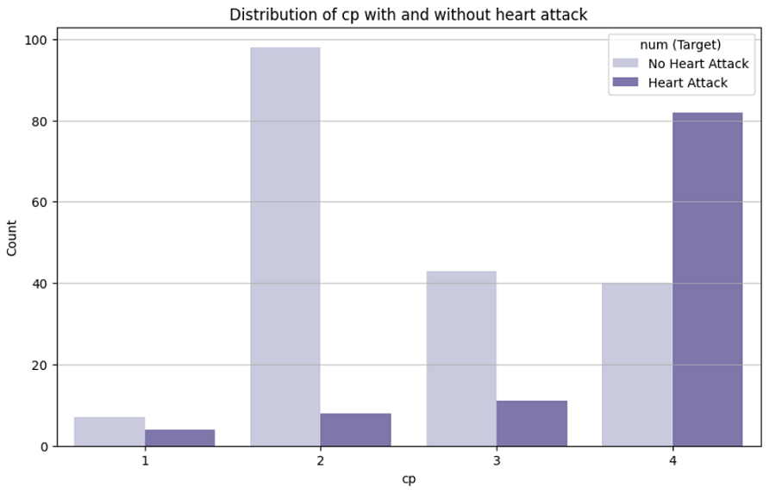
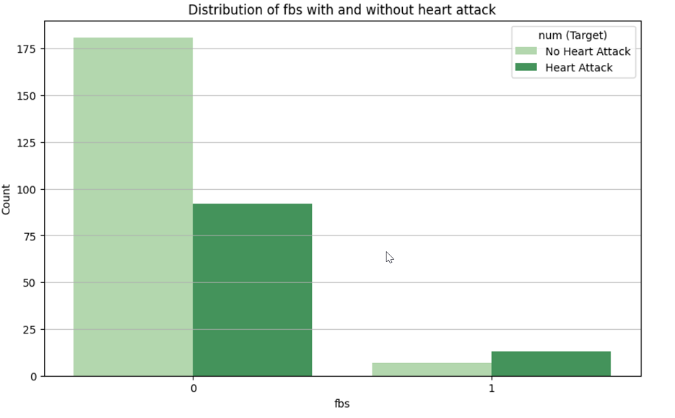
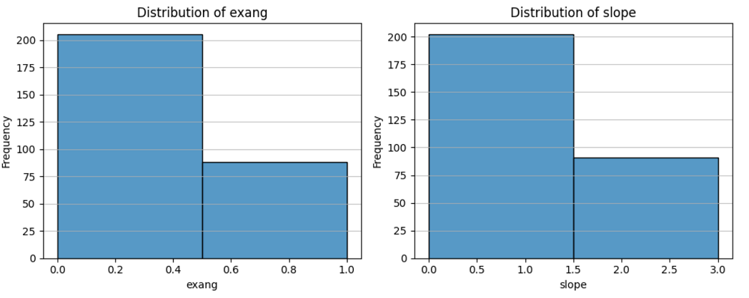
Examining Risk Factors - Categorical
Exploring Key Categorical Risk Factors such as:
--Chest Pain Type (Angina)
--Fasting Blood Sugar (FBS)
--Exercise-Induced Angina (exang)
--Slope of the Peak Exercise ST Segment

Slide 7
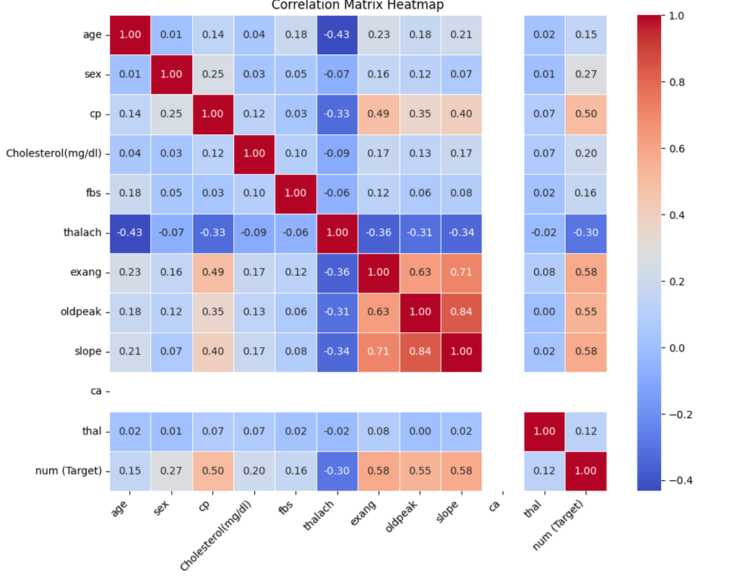
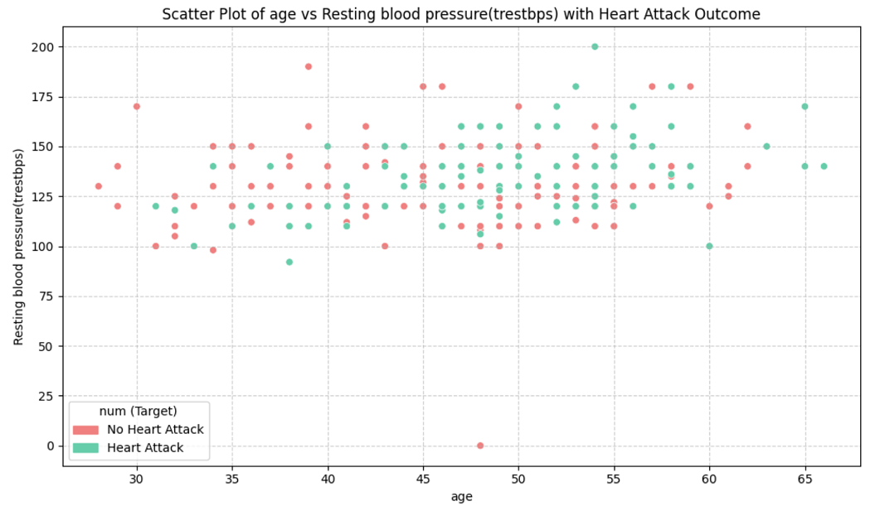
Correlations & Relationships
Heatmap of correlation matrix to show the relationship between features
Scatter plots of highly correlated Age vs. Blood pressure) with color encoding for heart attack outcome
Key InsightsThese data suggest that heart attacks are not solely caused by a single factor, and might be due to a combination of different features such as cp, exang, oldpeak and slope.

Slide 8
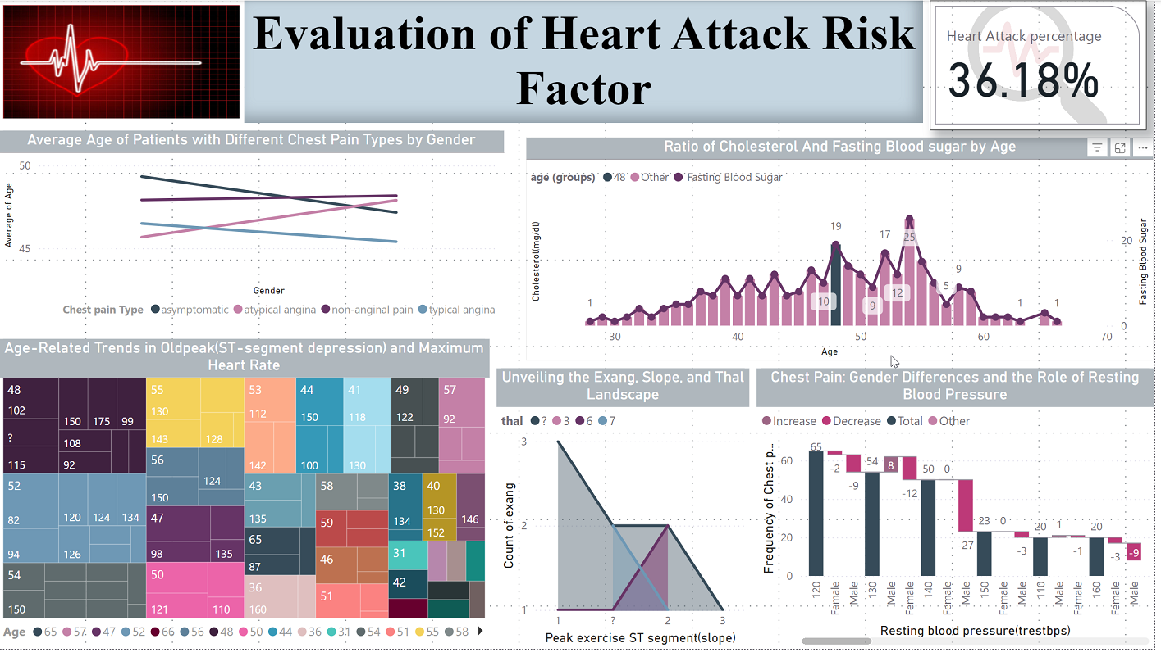
Predictive Modeling
Visualizing Heart Attack Risk Prediction with Power BI

Slide 9
Key Metric:
At the top right, a prominent number displays "Heart Attack percentage 36.18%". This indicates that approximately 36.18% of the patients in the dataset experienced a heart attack.
Individual Visualizations:
Average Age of Patients with Different Chest Pain Types by Gender:
Type: This is a line chart visualizing the average age of patients grouped by different chest pain types (asymptomatic, atypical angina, non-anginal pain, and typical angina) and further broken down by gender.
Purpose: This visualization is comparing the ages of patients based on their gender and chest pain type.
Ratio of Cholesterol and Fasting Blood Sugar by Age:
Type: This is a combination column and line chart showing cholesterol levels (columns) and fasting blood sugar levels (represented with a line) across different age groups.
Purpose: It explores how cholesterol and fasting blood sugar levels change with age.
Age-Related Trends in Oldpeak (ST-Segment Depression) and Maximum Heart Rate:
Type: This is a heatmap or table using color-coding to visualize the interplay of Age (x-axis) and old peak (ST depression) and max heart rate (values) .
Purpose: It aims to identify patterns in ST-segment depression (oldpeak), maximum heart rate and age.
Unveiling the Exang, Slope, Landscape:
Type: This appears to be an area chart showing the distribution of 'exang' (exercise-induced angina) across various values of 'slope' (peak exercise ST segment).
Purpose: To visualize the frequency of different slope categories across patients who experience or not exercise induced angina.
Chest Pain: Gender Differences and the Role of Resting Blood Pressure:
Type: This is a series of bar charts showing the frequency of chest pain types across genders at various resting blood pressure (trestbps) levels.
Purpose: This explores if there are variations of chest pain, across genders and different resting blood pressure levels.
The dashboard focuses on key risk factors associated with heart attacks like age, cholesterol levels, blood sugar, chest pain, and exercise-induced angina.
Presents a comprehensive analysis of heart attack risk factors by using different visualizations that help users explore these factors and understand their relationships.

Slide 10

Thank You & Q&A
"Questions?"

